Slide 2

Función de transferencia sin tiempo muerto: $G_{1}\left(s\right)=\frac{3}{\left(2s+1\right)\left(5s+1\right)}$
$$H_{1}\left(s\right)=\frac{1}{0,5s+1}$$
$$G_{o}\left(s\right)=G_{1}\left(s\right)H_{1}(s)$$
$$G_{o}\left(s\right)=\frac{3}{(5s+1)(2s+1)(0.5s+1)}=\frac{K}{\left(s−p_{1}\right)\left(s−p_{2}\right)\left(s−p_{3}\right)}$$
$$ω=2$$

Slide 3


$$u\left(t\right)=\sin\left(ωt\right)→U\left(s\right)=\frac{ω}{s^{2}+ω^{2}}=\frac{ω}{\left(s+jω\right)\left(s−jω\right)}$$
$$Y\left(s\right)=G_{o}\left(s\right)U\left(s\right)=\frac{ωK}{\left(s+jω\right)(s−jω)\left(s−p_{1}\right)\left(s−p_{2}\right)\left(s−p_{3}\right)}$$
$$Y\left(s\right)=\frac{A_{1}}{s+jω}+\frac{\overline{A_{1}}}{s−jω}+\frac{R_{1}}{s−p_{1}}+\frac{R_{2}}{s−p_{2}}+\frac{R_{3}}{s−p_{3}}$$
$$y\left(t\right)=A_{1}e^{−jωt}+\overline{A_{1}}e^{jωt}+R_{1}e^{p_{1}t}+R_{2}e^{p_{2}t}+R_{3}e^{p_{3}t}$$
$$y_{ss}\left(t\right)=\left|G_{o}\left(jω\right)\right|\sin\left(ωt+φ\right)→G_{o}\left(jω\right)=\left|G_{o}\left(jω\right)\right|e^{jφ}$$
$$y_{ss}(t)$$
Respuesta transitoria

Slide 4
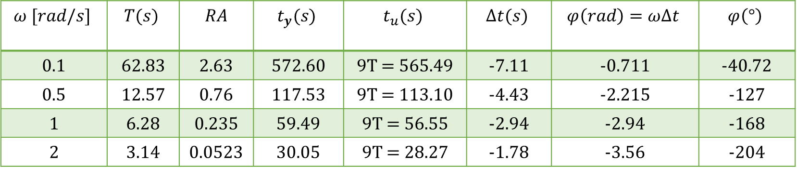

Ejercicio 3
$$Datos del diagrama de Bode$$
$$φ\left(rad\right)=2π\frac{∆t}{T}=ω∆t$$
$$ω [rad/s]$$ | $$T(s)$$ | $$RA$$ | $$t_{y}(s)$$ | $$t_{u}(s)$$ | $$∆t(s)$$ | $$φ\left(rad\right)=ω∆t$$ | $$φ\left(°\right)$$
0.1 | 62.83 | 2.63 | 572.60 | 9T = 565.49 | -7.11 | -0.711 | -40.72
0.5 | 12.57 | 0.76 | 117.53 | 9T = 113.10 | -4.43 | -2.215 | -127
1 | 6.28 | 0.235 | 59.49 | 9T = 56.55 | -2.94 | -2.94 | -168
2 | 3.14 | 0.0523 | 30.05 | 9T = 28.27 | -1.78 | -3.56 | -204

Slide 5
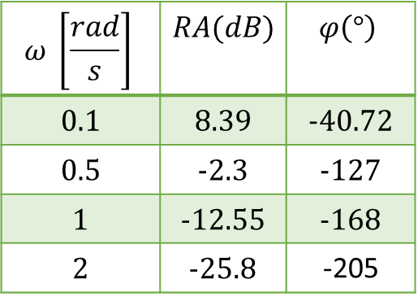
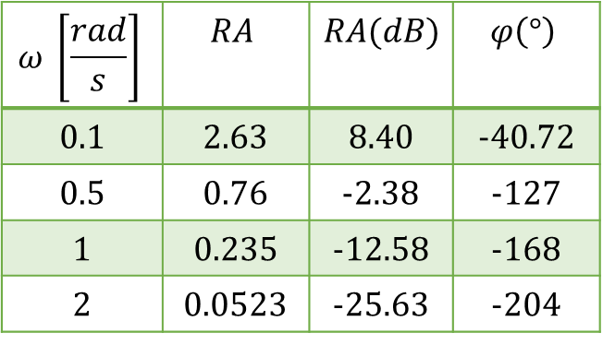
$$ω \left[\frac{rad}{s}\right]$$ | $$RA$$ | $$RA(dB)$$ | $$φ\left(°\right)$$
0.1 | 2.63 | 8.40 | -40.72
0.5 | 0.76 | -2.38 | -127
1 | 0.235 | -12.58 | -168
2 | 0.0523 | -25.63 | -204
$$ω \left[\frac{rad}{s}\right]$$ | $$RA(dB)$$ | $$φ\left(°\right)$$
0.1 | 8.39 | -40.72
0.5 | -2.3 | -127
1 | -12.55 | -168
2 | -25.8 | -205

